Slide 1


SMART INDIA HACKATHON 2025
Problem Statement ID- SIH25104
Problem Statement Title- Language Agnostic Chatbot
Theme- Smart Education
PS Category- Software
Team ID-
Team Name-Team BrainWave

Slide 2





UNITALK
Brainwave
Problem Statement
Students frequently face delays in accessing important institutional information such as fee deadlines, scholarships, timetables, and circulars.
Language barriers and complex documents often create confusion.
This results in long queues, repetitive queries, and communication gaps between students and campus offices.
There is a need for a multilingual, AI-powered conversational assistant.
The assistant should provide accurate, 24/7, and user-friendly access to institutional information.
It must work across web and messaging platforms while ensuring privacy and inclusivity.
Proposed Solution
Multilingual AI chatbot answering queries in 5+ regional languages
Ingests FAQs and notices with context retention
Integrates into college website & messaging apps
Cloud-based, modular architecture for scalability & privacy
Key Features
Multilingual Support
24 / 7 Access
Voice Input / Output
Fallback responses

Slide 3
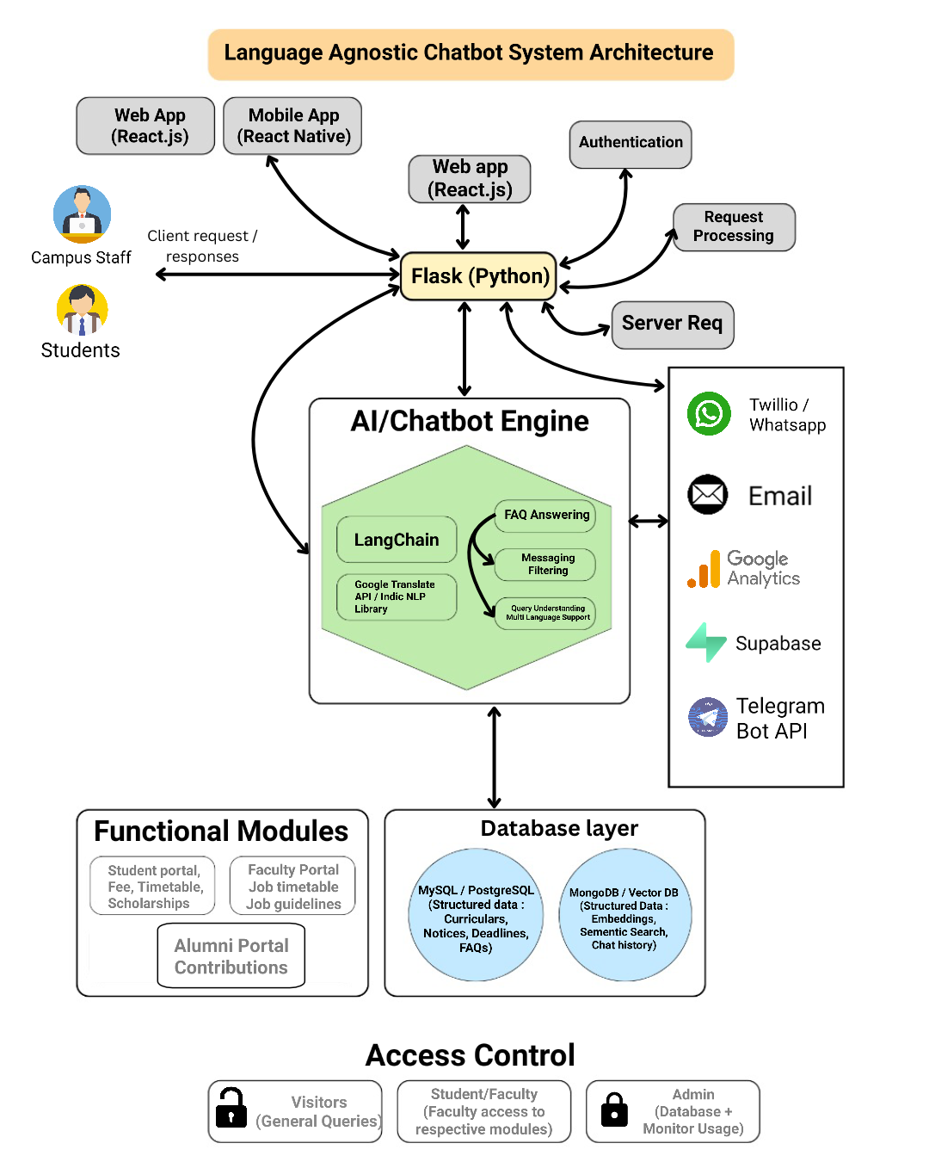
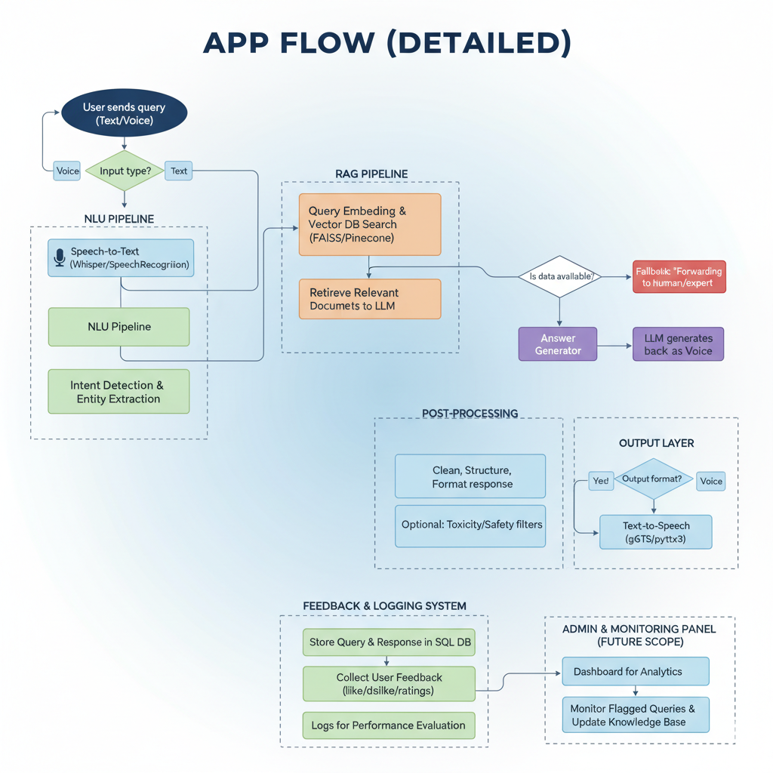
TECHNICAL APPROACH
Brainwave
Technology Stack
Technologies to be used
Programming Languages: Python , JavaScript
Frameworks & Libraries : React , pyTorch , Flask , LangChain, Whisper
Database : SQL
Hardware : Local Testing – Laptop with CPU / GPU support
Deployment : Vercel , SupaBase
Version Control : GitHub

Slide 4
FEASIBILITY AND VIABILITY
Brainwave
Project Feasibility
Uses existing AI models to reduce development time
Cloud backend with React/Vercel frontend for easy deployment
Modular architecture ensures scalability across institutions
Optimized for low-end devices to maximize accessibility
Challenges
Performance bottlenecks under heavy traffic
Data unavailability for certain institutional queries
Risk of misuse or abuse of messaging features
Privacy and security concerns in handling student data
Mitigation Strategies
Deploy lightweight, optimized AI models for efficiency
Provide fallback responses and escalate to faculty when needed
Implement rate limiting and content filters to prevent spam or abuse
Ensure secure authentication and encryption for data protection

Slide 5



IMPACT AND BENEFITS
Brainwave
Benefits
Social → Creates a connected, supportive campus environment
Economic → Saves time & resources for institutes
Environmental → Less reliance on printed circulars/notices
Data-Driven Insights →Conversation logs help institutes identify common pain points,
Scalable→ Once deployed, can be replicated across multiple institutes with little to no additional cost.
Future-Ready → Lays groundwork for integrating AI-driven academic
Impact
24/7 equitable access to academic information
Reduced communication gaps with administration
Inclusion for regional & underserved communities
Improved trust and transparency in institutions
Instant, reliable guidance for students

Slide 6
RESEARCH AND REFERENCES
Brainwave
Your Team Name
LangChain Docs – AI app framework 🔗 python.langchain.com
OpenAI API – GPT-based NLU & responses 🔗 platform.openai.com/docs
Supabase – Database, auth & storage 🔗 supabase.com/docs
Vercel – React/Next.js deployment 🔗 vercel.com/docs
Twilio WhatsApp API – Messaging integration 🔗 twilio.com/whatsapp
Telegram Bot API – Free bot framework 🔗 core.telegram.org/bots/api
Google Translate API – Multilingual support 🔗 cloud.google.com/translate/docs
Google Analytics – Web usage insights 🔗 analytics.google.com

